Slide 1
Unit 4
Functions & Procedures

Slide 2
Objective:
To Explore why we should use functions and procedures
To Learn what functions and procedures are about
To experiment how we can create and use functions and procedures

Slide 3
Review :
IPO Model: Input, process, output
Input, output, variable, constant: basic concepts for programming
Selection structure: if-elsif-then statement/case construct
Repetition structure: infinite loop/conditional loop/counted loop/nested loop/conditional counted loop
Graphics: character graphics/ pixel graphics
Array: 1D array and MD array

Slide 4
Why functions & Procedure?
Let us take a look at a Turing game
All the programs we have learned so far are relatively small and simple
When you try to write a longer program:
-- more likely to get confused
-- have programs that are not easy to
understand
Solution: keep programs small by subdividing larger programs into a number of subprograms.
-- relatively small and easy to understand
-- more important, can be more powerful with more
specific functionalities

Slide 5
What is a function?
Function: a subprogram that produces and returns a single value(answer) by using parameter(s)
When to use: e.g., in a Math unit for SA (surface area) and volume for 3D objects, you can:
-- create different functions to calculate the SA and volume for different objects
-- call those functions whenever needed

Slide 6
Types of Functions
Predefined Functions
e.g. put sqrt(36)
Type Transfer Functions
  e.g. intstr(number) – convert an integer to a string
  strreal(string) – convert a string to real
User Defined Functions
e.g. let’s try to create a function called
square to calculate the square of a number
(square.t)

Slide 7
%square.t
function square (number : real) : real
result number ** 2
end square
var n:real
put “Enter a number: ”..
get n
put “The square of ”, n:2, “ is ”, square(n)

Slide 8
What is a procedure?
Procedure: a subprogram that can return many values using one or more parameters,or may return no value or have no parameter
When to use: e.g., we don’t have drawtriangle procedure in Turing (a little bit inconvenient); What we can do is to create our own procedure that to draw a triangle and complete the performance

Slide 9
Types of Procedures
Procedures with no Parameters
e.g. Draw a triangle using character graphics (triangle.t)

Slide 10

Types of Procedures
Procedures with Value Parameters
e.g. Write a procedure drawRect that prints a rectangular pattern of the character SYMBOL that is WIDTH characters wide and HEIGHT characters high. The values of SYMBOL, HEIGHT, and WIDTH should be defined as constants within the procedure. As an example, if we have SYMBOL = '*', HEIGHT = 3, and WIDTH = 8, the procedure should print the following pattern:
(drawRect.t)

Slide 11
Types of Procedures
Procedures with Variable Parameters
(used when values of parameters need to be changed)
e.g. Create a program to input two number, swap them and then output the result
(swap.t)

Slide 12
Functions vs. Procedures
Which to use?
Guideline
A subprogram calculates and returns a single value (answer) → function
A subprogram does not change or return any value → procedure
A subprogram changes and returns multiple values → procedure

Slide 13
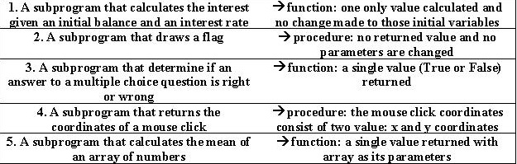
More Examples

Slide 14
Resources
Hume, J.N.P. Problem Solving and Programming in Turing. Toronto: Holt Software Associates Inc., 1993. ISBN 0-921598-16-5
http://compsci.ntci.on.ca/tik/

Slide 15
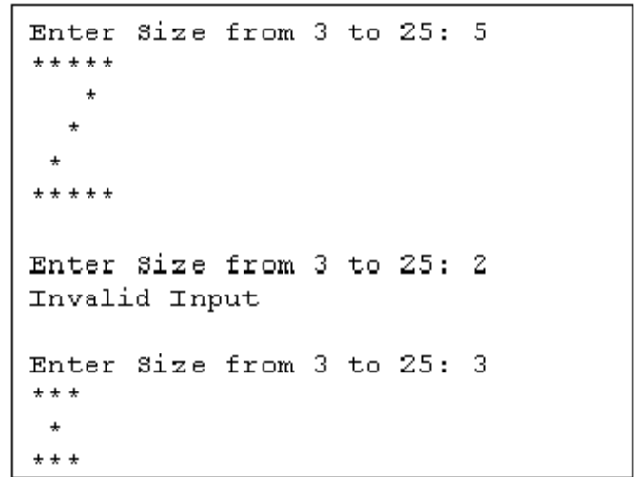
In class exercise
Create a function that calculates the volume of a pyramid. Ask user for radius and height then print out the result.
Volume of Pyramid = 1/3 * Area of Base * Height
= 1/3 * PI * Radius * Radius * Height
Modify the zPattern.t by using procedure (Q2 for A10). Prompt user for a number between 3 to 25 then draw a “Z” in corresponding size.
Note:
Upon completion, please submit
to In-class exercise folder

